Slide 1
God didn’t answer my prayer. Now what?
Adam Oldham
Camp Hill church of Christ
Encouragement Weekend

Slide 2
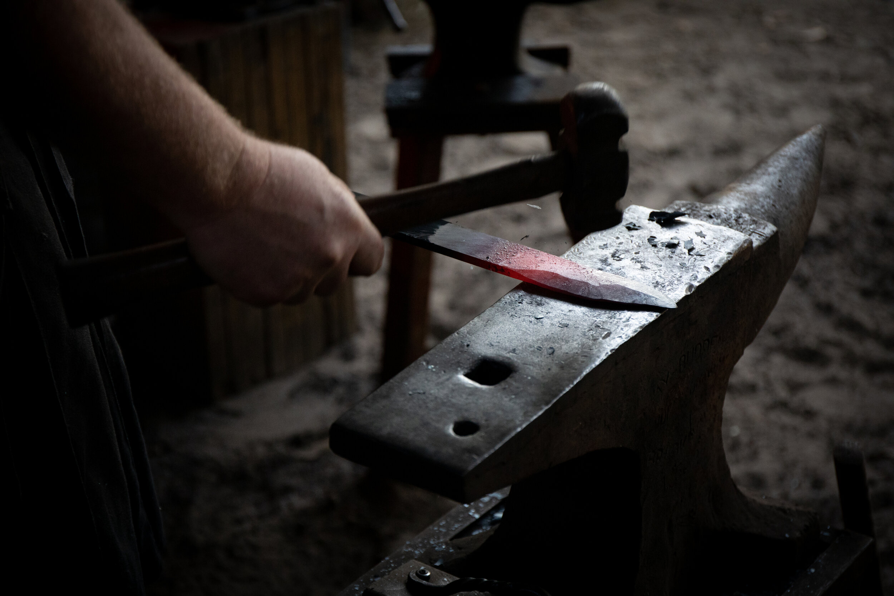
ANVIL or HAMMER?

Slide 3
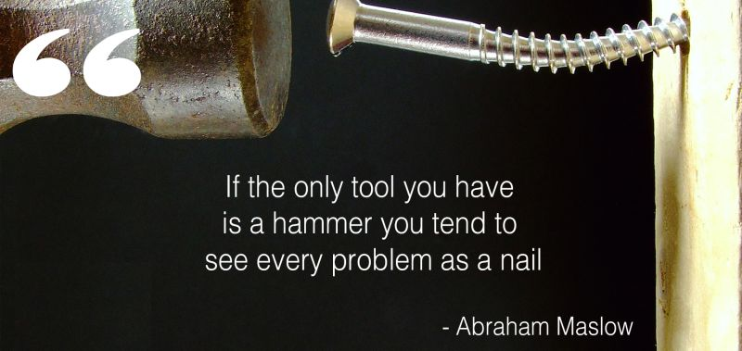

Slide 4
KEY TAKE AWAY #1
We have a role to play in receiving an answer to our prayers.
“Have I done my part?”

Slide 6
God didn’t answer my prayer – now what?
We have a role to play in receiving an answer to our prayers.
We reap what we sow.
(Galatians 6:7)
“Have I done my part?”

Slide 7
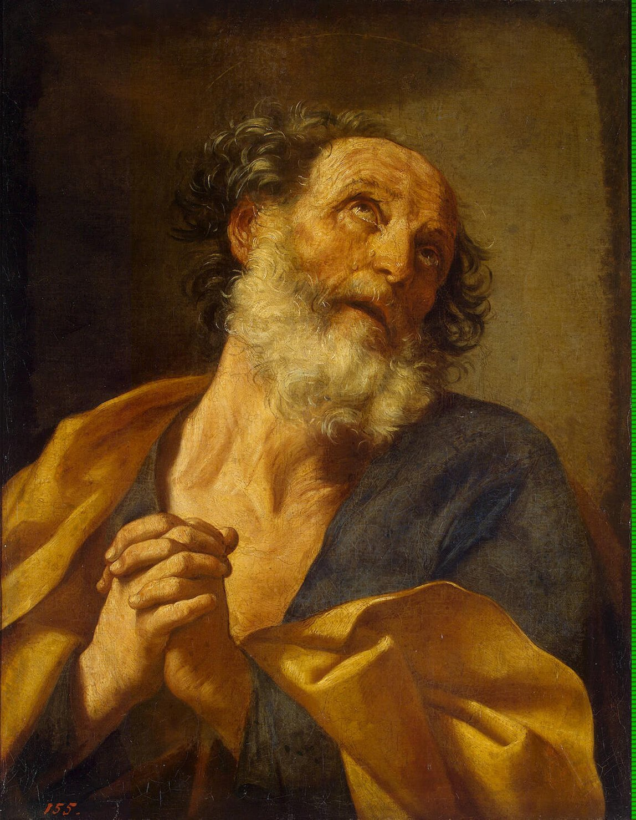
Your
“stomach”
and your
“frequent
ailments"
(Eye roll)

Slide 8
God didn’t answer my prayer – now what?
so far as it
depends on you
(Romans 12:18)
“Have I done my part?”

Slide 9
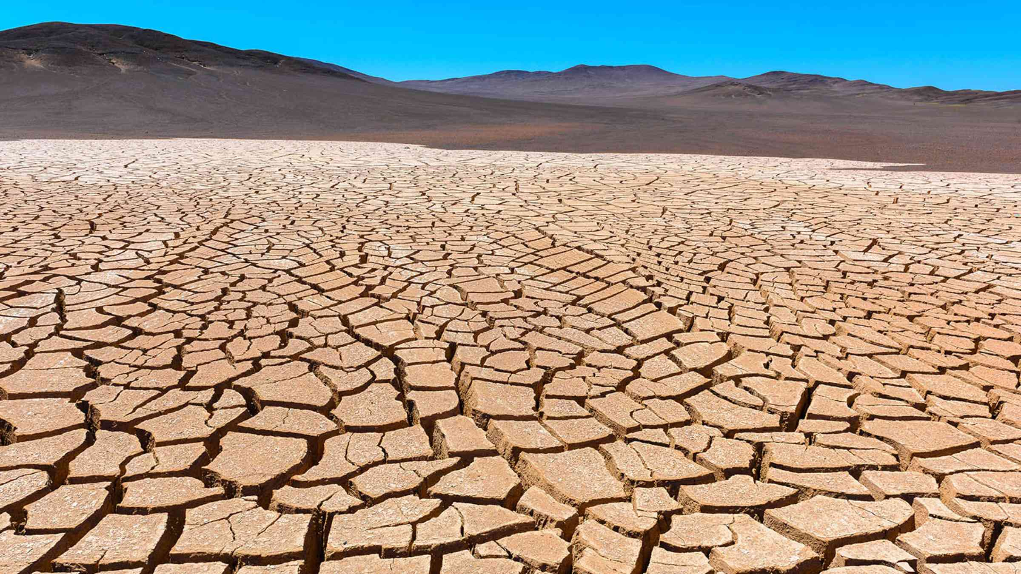
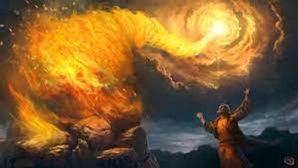
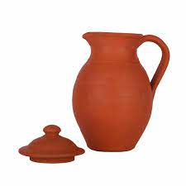
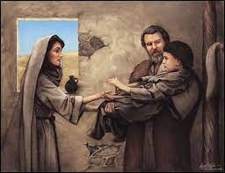

Slide 10
KEY TAKE AWAY #2
We need to learn
to be content
with where we are.
“What if God’s answer is different than the answer I wanted?”

Slide 11
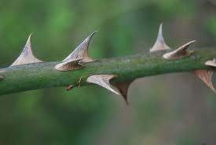
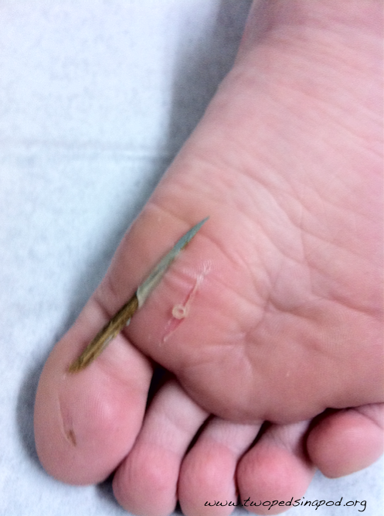
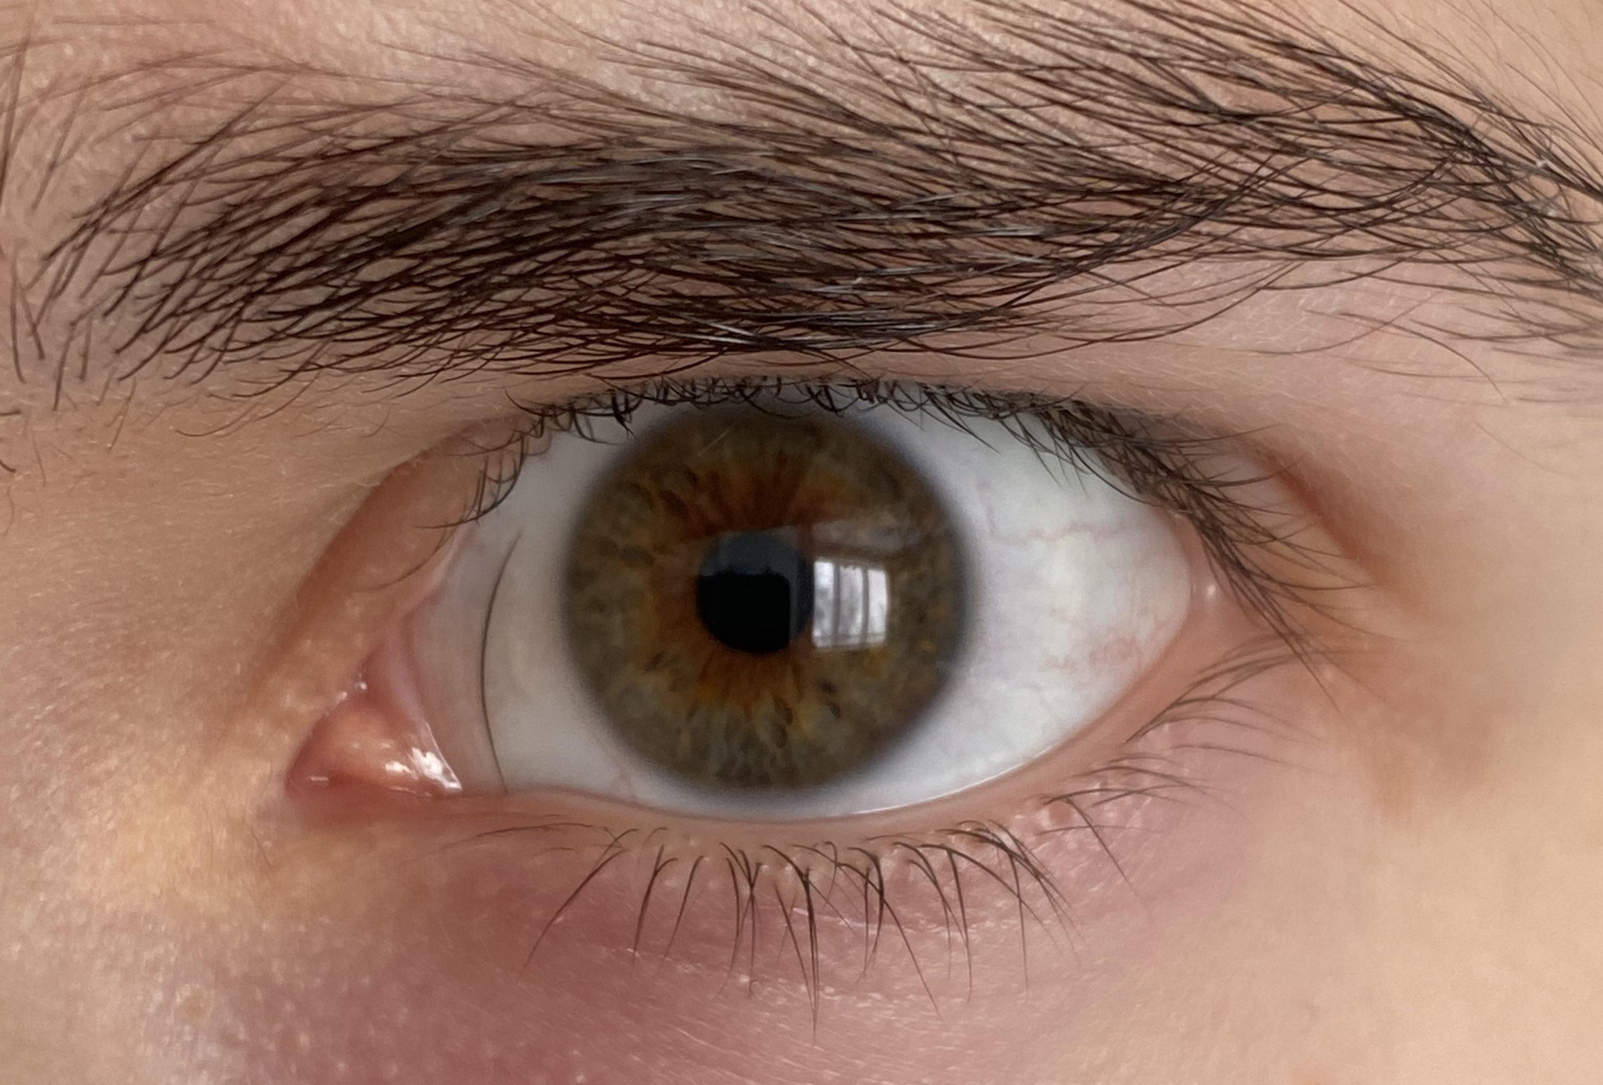

Slide 12
God didn’t answer my prayer – now what?
My grace
is sufficient for you,
for my power
is made perfect
in weakness.
(2 Corinthians 12:9)
“What if God’s answer is different than the answer I wanted?”

Slide 13
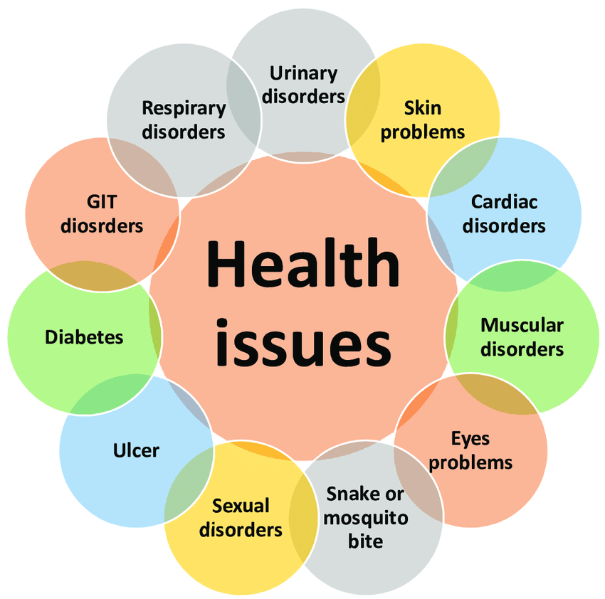
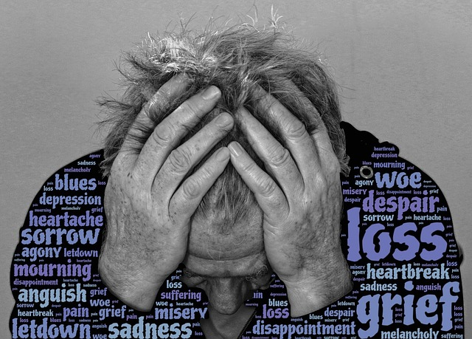

Slide 14
God didn’t answer my prayer – now what?
When I am weak,
then I am strong.
(2 Corinthians 12:10)
“What if God’s answer is different than the answer I wanted?”

Slide 15
When I am weak,
then I am strong.
OPPORTUNITY
STRENGTH
USEFUL
CONNECTEDNESS
SEEN
GRACE AND LOVE
GOD’s grace
GOD’s power
STUCK/TRAPPED
WEAKNESS
USELESS
ISOLATION
INVISIBLE
UNLOVED
When I am weak,
then I am weak.
MY perspective
MY strength

Slide 16
God didn’t answer my prayer. Now what?
Have I done my part?
Has God given me a different answer?
In all situations, allow the works of God to be displayed in your life!

